Slide 1

Industrial Combustion Energy Use
Group 4
Mentor :
Shubham Kabra
Gowrishankari Padmanathan
Team :
Changalpatt Pravalika
Anukeerthi Reddy P
Pedda. Manoj Venket Shiva Kumar
Pankti Rashmin Satra
Sudhindra Kulkarni
Muthuraman M
Project 51 Group-4

Slide 2


MMBtu_TOTAL for Ethane & Ethanol
Process Heating for 3M Company
Unit Name Trend (1950-2022) Vs GWht_TOTAL
% Share of Direct Uses –Total Non process for each MECS_Region
County wise Conventional Boiler Use Stats

Slide 3

MMBtu_TOTAL for Ethane & Ethanol
Percentage share of Ethane(0.0526%) is higher than Ethanol(0.0008%) in MMBtu_TOTAL.
Ethane stands in 21st position and Ethanol stands in 43 position among 50 different fuel types.
CHP and/or Cogeneration process of Ethane(0.07M) where as for Ethanol(0).
When we compare both fuel types, Ethane is higher in all parameters compared with Ethanol.
So, we can say Ethane is widely used rather than Ethanol.
Ethane

Slide 4

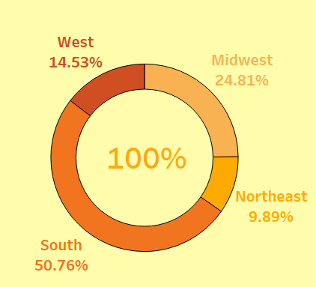
Process Heating for 3M Company
The Sum total of process heating for the 3M COMPANY is 22,251 units.
Of the 5747 different facilities, 3M Company ranks at 208(904) in Process heating units consumed.
MOTIVA ENTERPRISES LLC Facility makes use of maximum Process heating with 9528387 units.
Of the 27,90,98,909 Total units, 3M Company % Share is at .0081% whereas MOTIVA ENTERPRISES LLC is at 3.4497%.
3651 facilities does not make use of Process heating

Slide 5
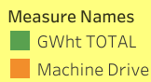
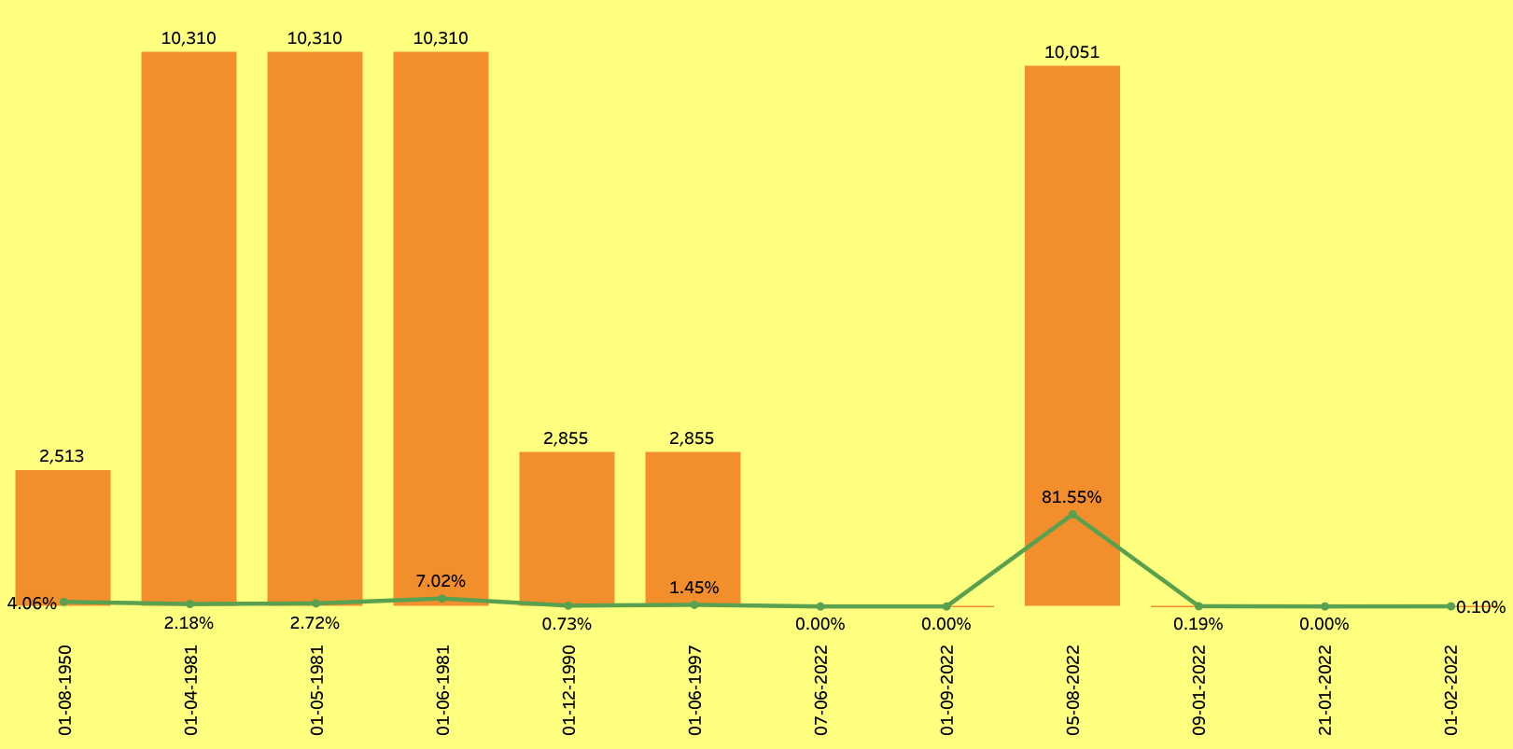
Unit Name Trend (1950-2022) Vs GWht_TOTAL
We are comparing unit name trend of 5 different years with GWht_TOTAL from 1950 to 2022 .
Where we can see 0% share in 07-06-2022 and lowest value is 0.10% in 01-02-2022kickstart value is 4.06% which is in 1950 and the Highest is 81.55% 08-2022.
We also compared this trend with machine drive where we can see 10,310 in the year 1981 less value is 2,513 in 1950 and latest 2022 value is 10,051 which is comparatively almost near to 1981 value.

Slide 6
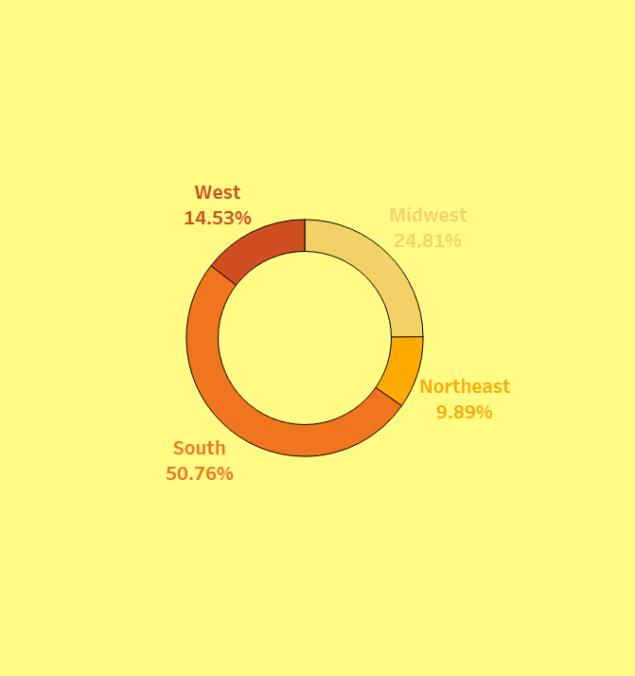
% Share of Direct Uses –Total Non process for each MECS_Region
Sum is 13M which is more than 50% covering 339 County.
South Region share in Direct Uses-Total Process, Other Process Uses, Onsite Transportation is more than 50%
Rank by MECS Region is South, Midwest, West & Northeast.
Progress can be made in the Northeast Region.
Total 13 M

Slide 7
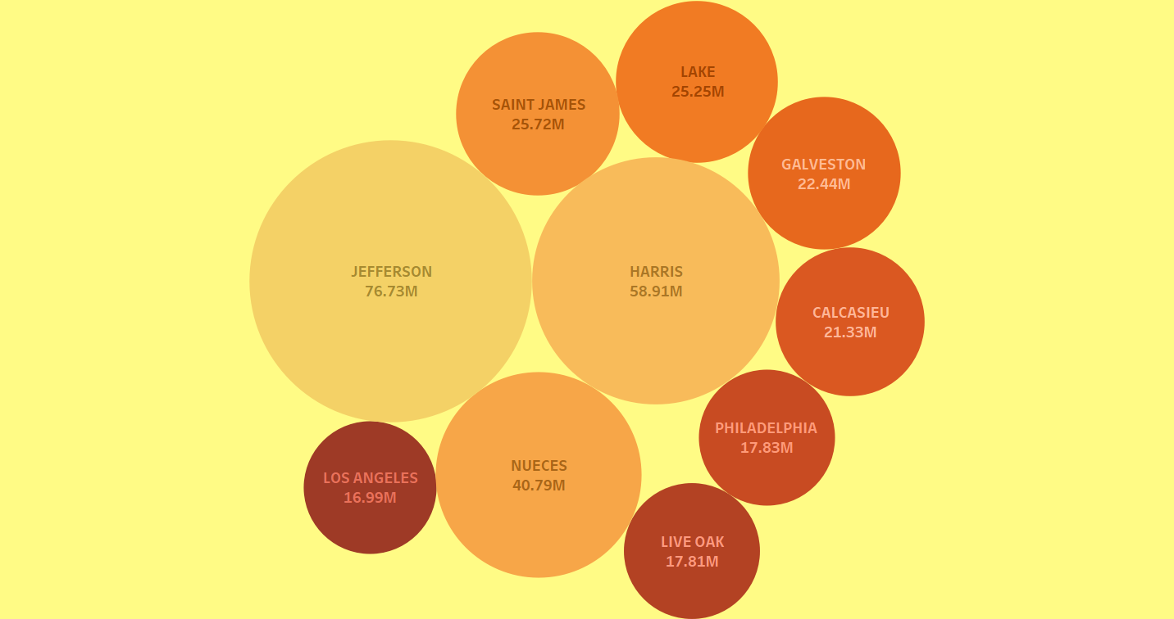
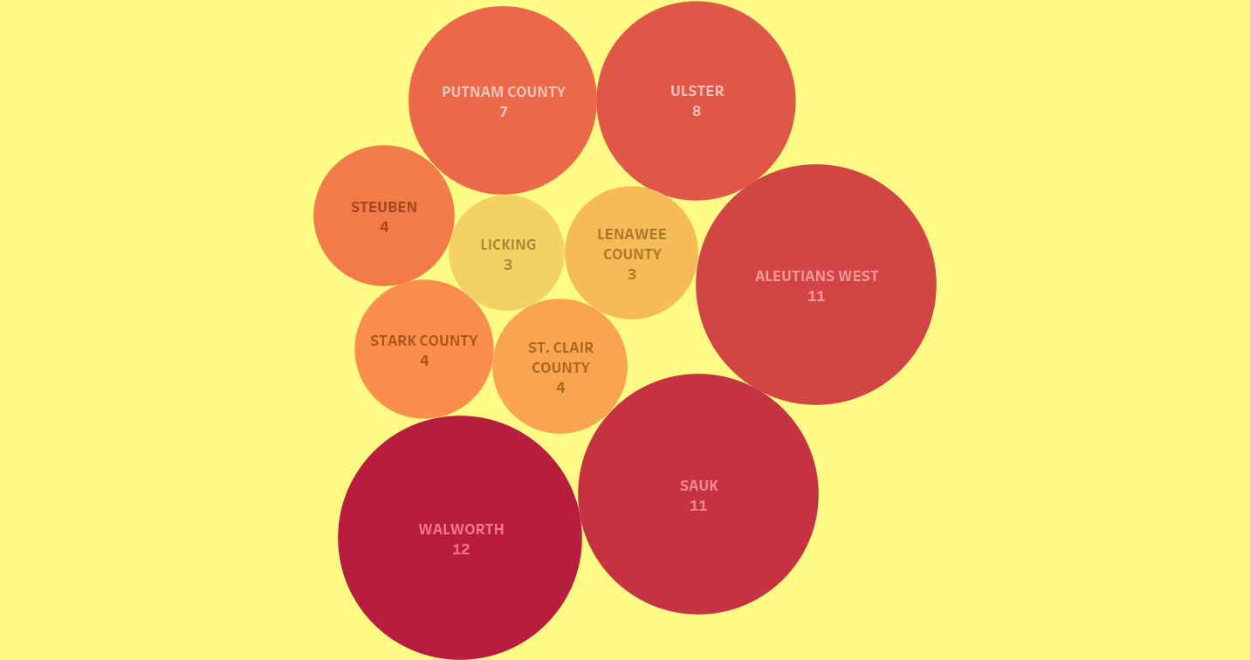
County wise Conventional Boiler Use Stats
TOP 10
Total Average 89.22K
Above graph represents Top 10 County whereas below graph Bottom 10 County.
Total Sum of Conventional Boiler Use is 733.67M.
Average of Conventional Boiler Use is 89.22K.
Maximum value of Conventional Boiler User is 0.41M.
Values have a very big variation.
Maximum
0.41M
Total Sum
733.67M
BOTTOM 10

Slide 8




Thank you

